Slide 1


SMART INDIA HACKATHON 2026
Problem Statement ID –SIH26180
Problem Statement Title- AquaMind Sentinel-That decides every drop before it falls.
Theme- Smart Agriculture
PS Category- Software+hardware
Team ID-
Team Name – Team AquaMind

Slide 2
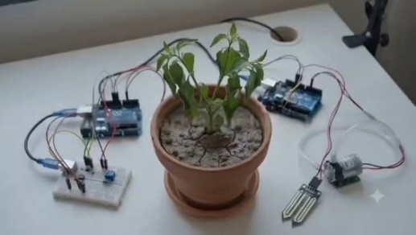
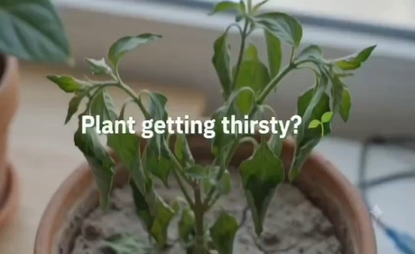
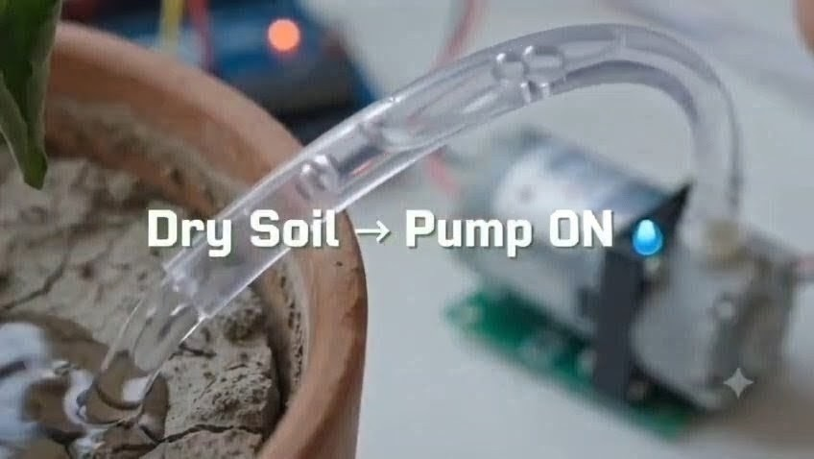
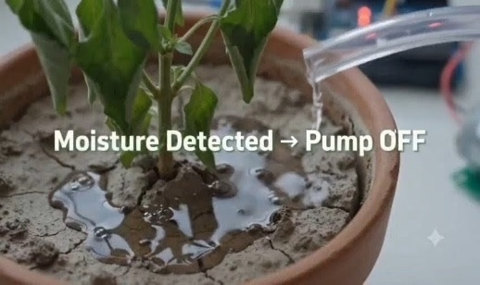
Proposed Solution
Team
AquaMind
Understanding problem :
1.Water Wastage:
2.Lack of Monitoring:
3.Unpredictable Weather:
4.Manual Dependency:
5.Limited Intelligence:
PRopoSED SOLUTION :
1.Real-Time
2.Smart Irrigation
3. Weather Integration
4.Remote Monitoring
5.Automatic Alerts
1.AI-Based Decisions: Combines sensor and weather data for intelligent irrigation decisions.
2.Predictive Irrigation: Avoids watering when rainfall is expected, saving water.
3.Multisensor Intelligence: Integrates soil moisture, temperature, humidity, rain sensor, and Weather API.
4.Autonomous Operation: Enables automatic irrigation with minimum human intervention.
5.Location-Based Weather: Provides region-specific weather information for better decisions.
6.Water-Efficient & Scalable: Suitable for farms and nurseries with scope for larger deployment.
OUR UNIQUE SOLUTION :

Slide 3
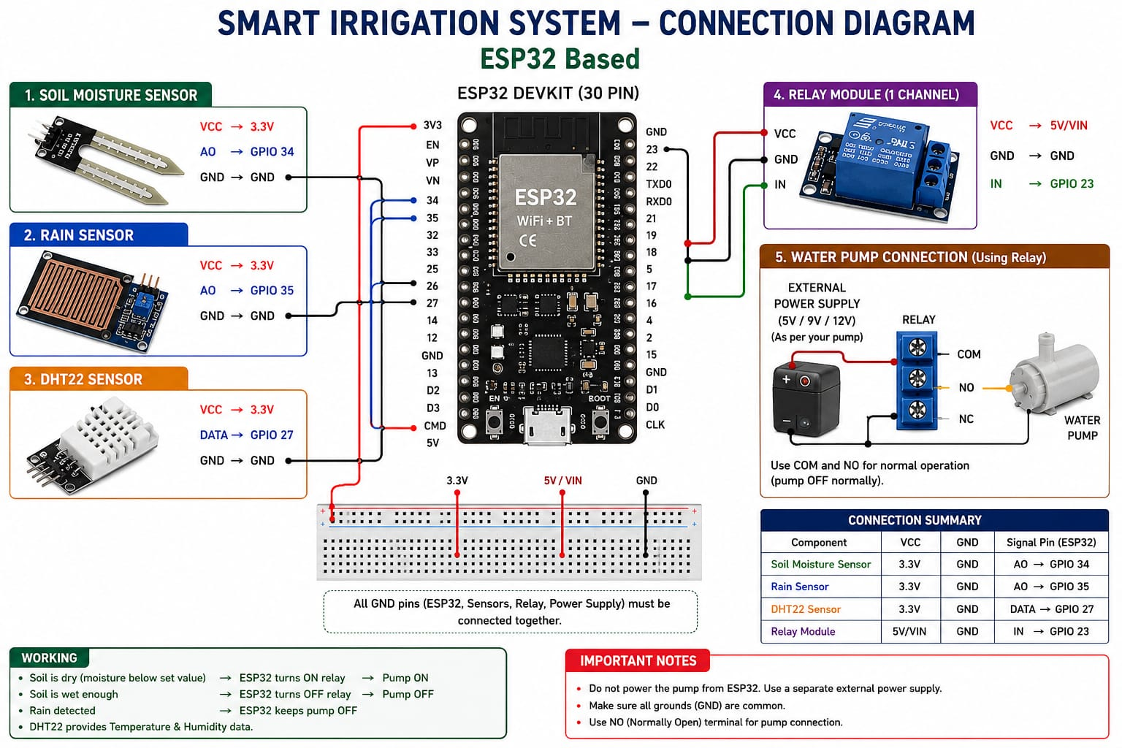
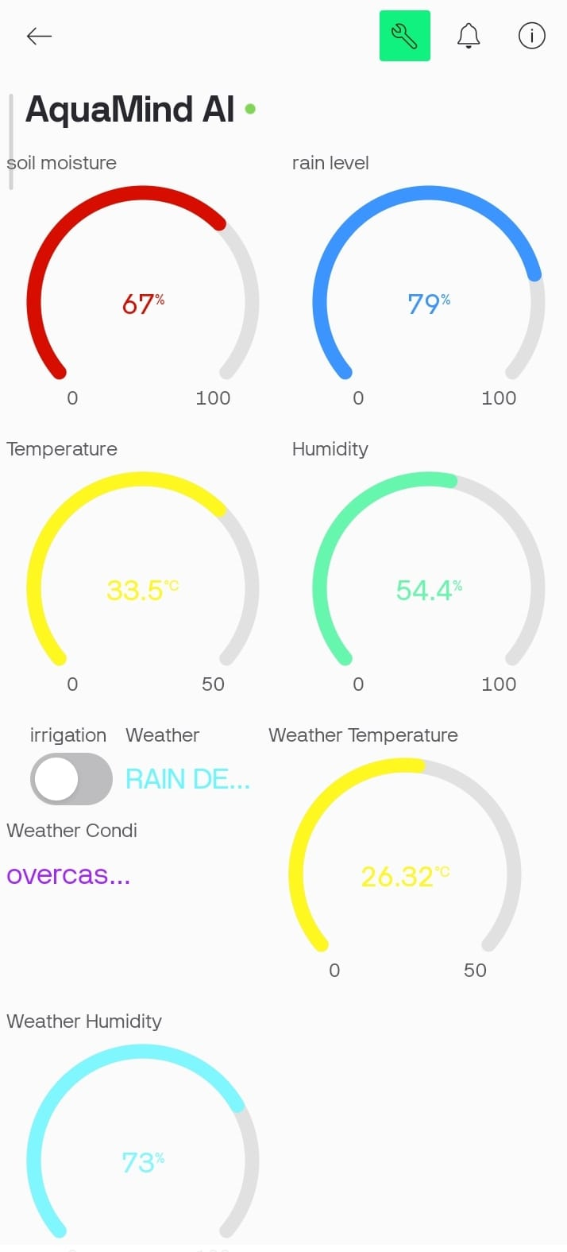
TECHNICAL APPROACH
Team
AquaMind
“What Happens in 10 Seconds?”
Show the entire project in a single timeline:
0s → Sensor reads soil
2s → ESP32 processes data
4s → Weather/rain condition checked
6s → AI makes decision
8s → Relay responds
10s → Blynk dashboard updates
1.Sensors: Soil-moisture
2.AI & Machine Learning:
3.ESP32 / Edge Computing
4.Weather API
5.Automatic Irrigation
6.IoT & Cloud Dashboard
7.Regional & Soil Intelligence

Slide 4
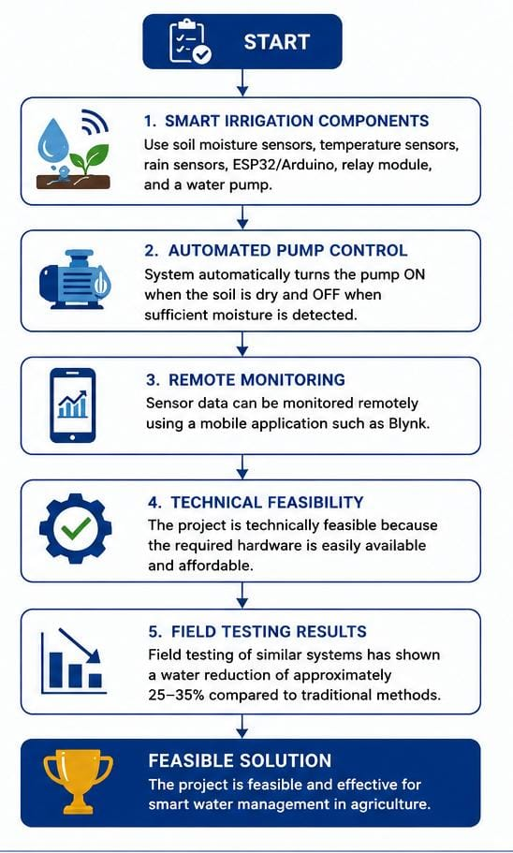
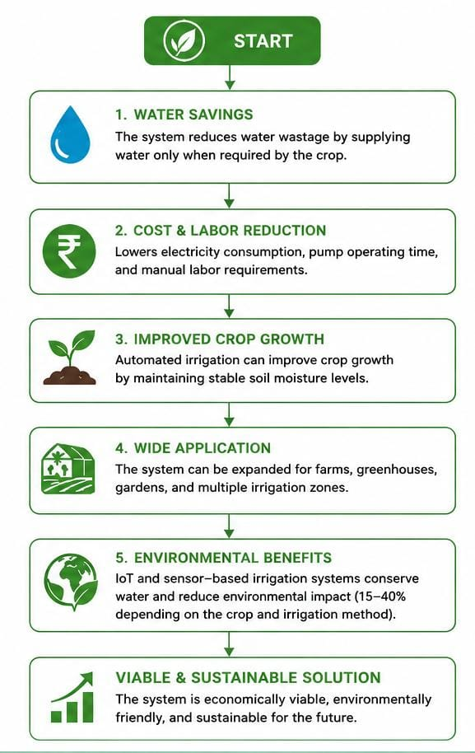
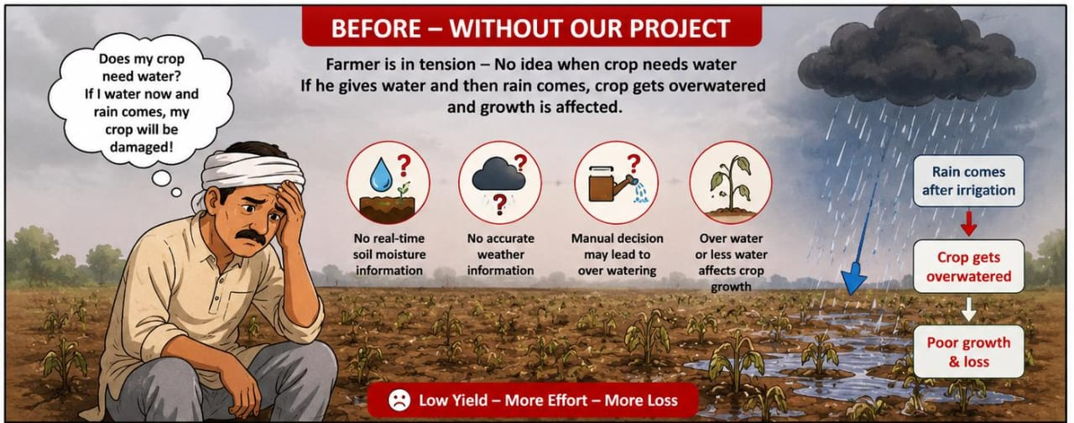
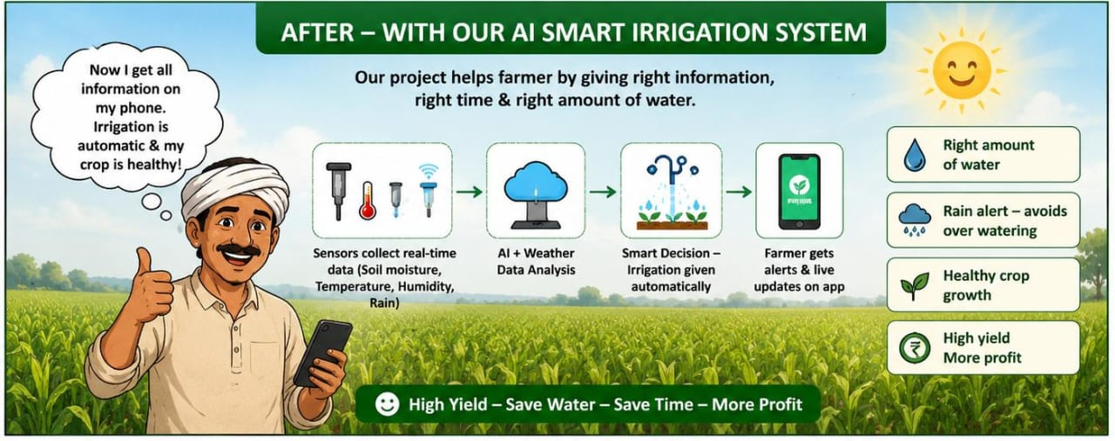
FEASIBILITY AND VIABILITY
Team
AquaMind
Feasibility
Viability

Slide 5
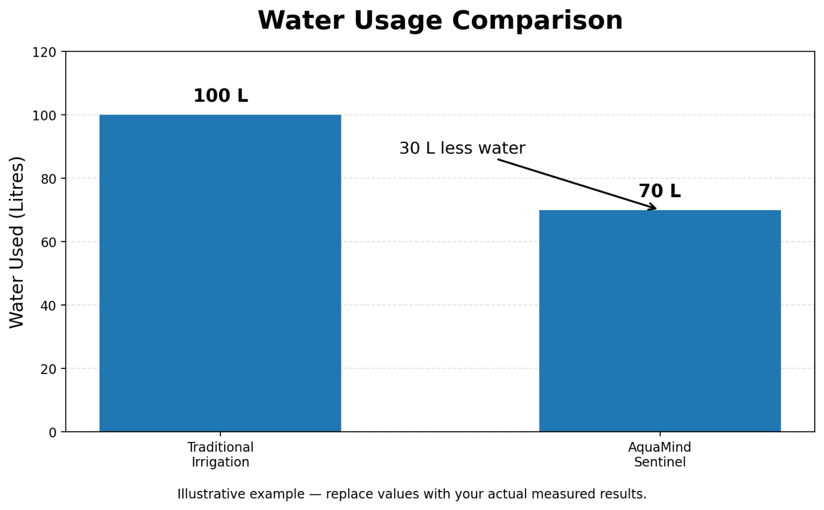
IMPACT AND BENEFITS
Team
AquaMind
Impact :
1.Water Conservation – Reduces unnecessary water usage through precise irrigation.
2.Higher Crop Productivity – Provides crops with the right amount of water at the right time.
3.Sustainable Farming – Promotes efficient use of water and other agricultural resources.
4.Climate Adaptability – Uses weather forecasts to adjust irrigation during rainfall, heat, or changing condition
BENEFIT :
1.Automatic Irrigation – Reduces the need for manual control of water pumps.
2.Real-Time Monitoring – Farmers can monitor soil moisture, temperature, humidity and irrigation status remotely.
3.Cost Reduction – Saves water, electricity and labor costs
4.Smart Decision Making – AI combines sensor and weather data to provide more accurate irrigation decisions
Useful :
Helps farmers make
Better irrigation
Decisions and improve crop growth.
Economical Benefits:
Saves water , electricity,
And
Farming cost.

Slide 6
RESEARCH AND REFERENCES
Team
AquaMind
1.Problem statement :
“The problem was identified through real-world observations and interactions with farmers, where we observed water wastage caused by irrigation based on fixed schedules rather than actual soil and weather conditions.”
2. Ali, Awais, Tajamul Hussain, and Azlan Zahid. "Smart irrigation technologies and prospects for enhancing water use efficiency for sustainable agriculture." AgriEngineering 7.4 (2025):106. [https://www.mdpi.com/2624-7402/7/4/106]
3. Blessy, J. Angelin. "Smart irrigation system techniques using artificial intelligence and IoT." 2021 Third International Conference on Intelligent Communication Technologies and Virtual Mobile Networ): ks (ICICV). IEEE, 2021.[https://ieeexplore.ieee.org/abstract/document/9388444/]
4.Kaushik, Shambhavi, and Karan Singh. "AI-driven smart irrigation and resource optimization for sustainable precision agriculture." Europe 250 (2025): 70.[https://www.jsiar.com/2025-May/JSIAR-M-25-05444.pdf]
5. ChatGPT.
6. Perplexity.
7. https://youtu.be/pOB8-pi796I?si=WMq0YsQifSBO8Xcs
8. https://www.codechef.com/learn/course/python

